Slide 1
Introduction to C++
An Object Oriented Language
Siddhartha Shankar Das
siddhartha047@gmail.com

Slide 2
What makes a language Object Oriented?

Slide 3
Is C an Object Oriented Language?

Slide 4
Why C is not an Object Oriented Language?

Slide 5
Why C is not considered Object Oriented language?
Because it doesn’t support
Polymorphism
Encapsulation
Inheritance
We will get to that in the following classes…. But you can check here if you want

Slide 6
C programming Language
Advantages
C structured programming is simple and easy to understand and implement.
It is well suited for small size implementation. However this is not restricted. A good design can extend it to large size implementation.
Programmers do not require to know complex design concepts to start a new program.
Disadvantages
Data and methods and not be bind together in a module.
Polymorphism and inheritance are not available.
Complex design and full object oriented design cannot be implemented.
Programmers generally prefer object oriented programming language over structured programming language when implementing a complex gaming applications or front end business applications.

Slide 7
What C++ Offers more than C Other than Object oriented concept?

Slide 8
What C++ offers than C
Variable declarations in conditionals, C99 only has it in for

Slide 9
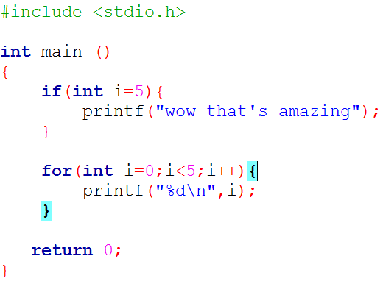
What C++ offers than C
Variable declarations in conditionals, C99 only has it in for

Slide 10
What C++ offers than C
Variable declarations in conditionals, C99 only has it in for
Function overloading

Slide 11
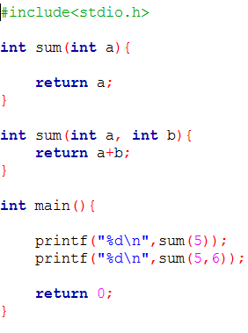
What C++ offers than C
Variable declarations in conditionals, C99 only has it in for
Function overloading

Slide 12
What C++ offers than C
Variable declarations in conditionals, C99 only has it in for
Function overloading
Templates

Slide 13
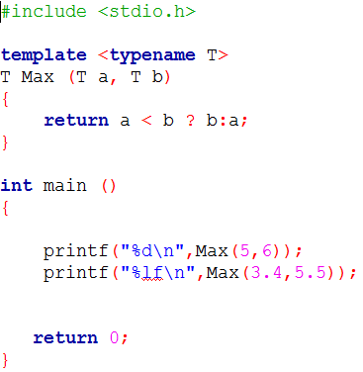
What C++ offers than C
Variable declarations in conditionals, C99 only has it in for
Function overloading
Templates

Slide 14
What C++ offers than C
Variable declarations in conditionals, C99 only has it in for
Function overloading
Templates
References

Slide 15
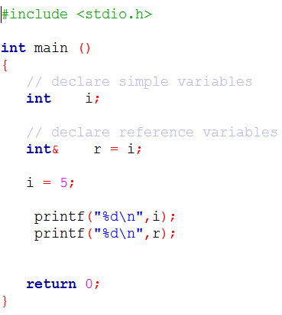
What C++ offers than C
Variable declarations in conditionals, C99 only has it in for
Function overloading
Templates
References

Slide 16
What C++ offers than C
Variable declarations in conditionals, C99 only has it in for
Function overloading
Templates
References
you can use structs and enums without writing struct or enum before every declaration or using typedefs.

Slide 17
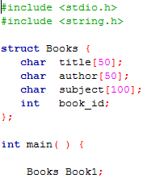
What C++ offers than C
Variable declarations in conditionals, C99 only has it in for
Function overloading
Templates
References
you can use structs and enums without writing struct or enum before every declaration or using typedefs.

Slide 18
What C++ offers than C
Variable declarations in conditionals, C99 only has it in for
Function overloading
Templates
References
you can use structs and enums without writing struct or enum before every declaration or using typedefs.
Operator overloading
Namespaces
Exceptions
even if you don't define your own classes, using C++'s string and container classes is still often more convenient and safe to work with than c-style strings and arrays.
Type safety (even though some would call it weak)
more…………...

Slide 19
Introduction to a C++ Program

Slide 20
Basic Program Structure

Slide 21
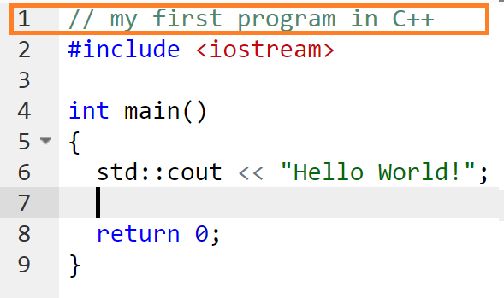
An analysis on Hello World Program
The best way to learn a program language by writing a program
Line 1. Comment. Has no effect on program

Slide 22
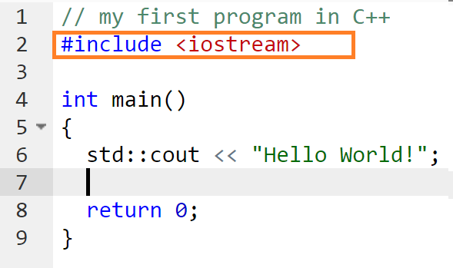
An analysis on Hello World Program
The best way to learn a program language by writing a program
Line 2. Directive #include <iostream>, instructs the preprocessor to include a section of standard C++ code, known as header iostream, that allows to perform standard input and output operations, such as writing the output of this program (Hello World) to the screen.

Slide 23
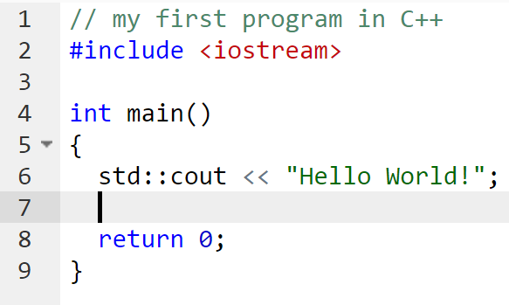
An analysis on Hello World Program
The best way to learn a program language by writing a program
Line 3,7. Blank lines. Offers readability
Line 4-5, 8-9 Main function definition

Slide 24
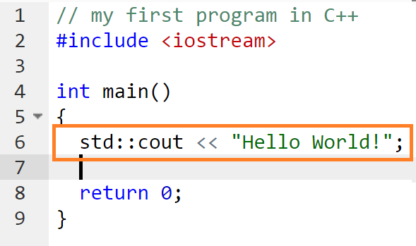
An analysis on Hello World Program
The best way to learn a program language by writing a program
Line 6 Actually the meat of the program
std::cout defines character output function which is defined in standard namespace,
so it named standard character output
(here computer screen) << takes the parameter the string “hello world!” for output

Slide 25
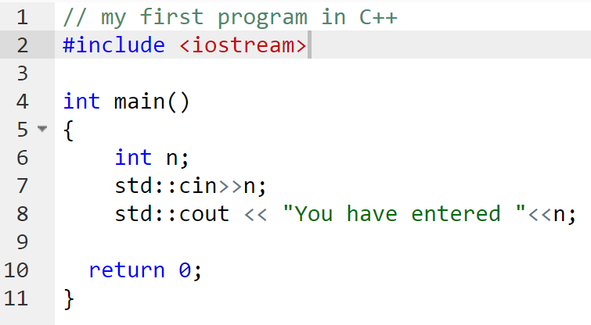
A simple input output program
As like as cout there is also character input called cin can be used to take any basic types of standard input and cout can be used to give output of basic types.

Slide 26
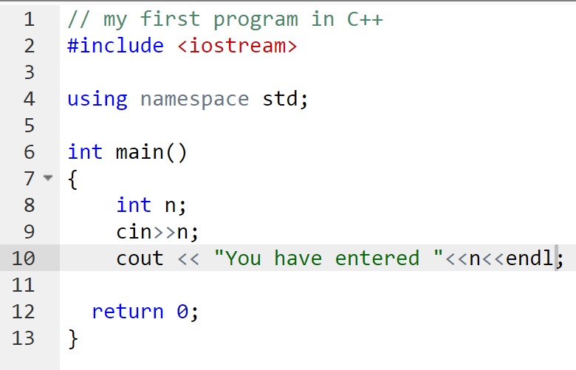
A simple input output program
But writing std everytime for standard input output functions is kind of weird.
So the most common ways is to add using namespace std after #include directives.
It means we are going to refer the standard library functions unambiguously. We are not going to write any functions that conflicts with these standard function names and parameters

Slide 27
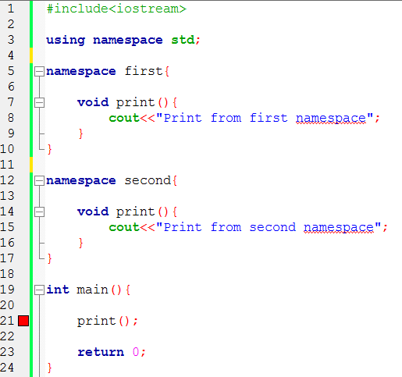
Namespaces
As you can see, ambiguous.
So alternative is to.

Slide 28
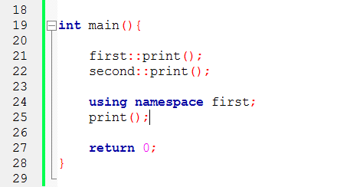
Namespaces
Solution
Either using namespace namespace-name
using ::

Slide 29
Input & Output
Variable & types
Constants
Operators Trivial As C

Slide 30
Input & Output
cin standard input stream
cout standard output stream
cerr standard error (output) stream
clog standard logging (output) stream
The later two typically gives output to console unless you redirect them.

Slide 31
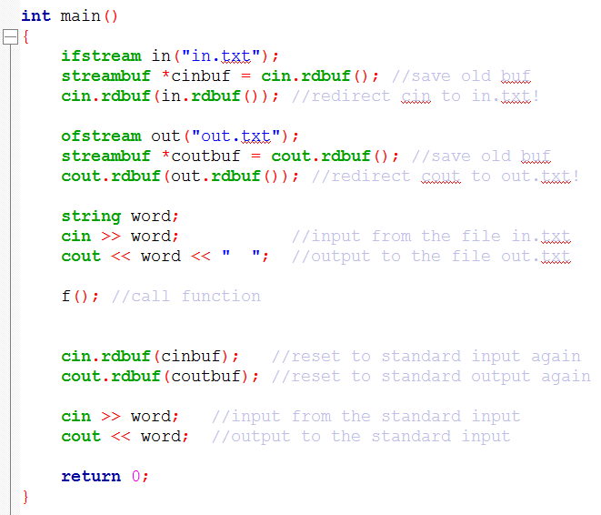
Input & Output
cin standard input stream
cout standard output stream
cerr standard error (output) stream
clog standard logging (output) stream
The later two typically gives output to console unless you redirect them.
We will discuss them later

Slide 32



Input & Output
We will focus on cin, cout for now.

Slide 33

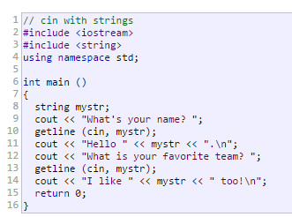
Input & Output
We will focus on cin, cout for now.

Slide 34
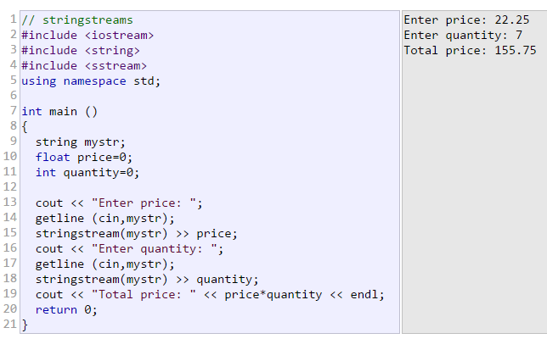

Input & Output
We will focus on cin, cout for now.
Codes are here

Slide 35
Getting in touch with Class
Practice Problem given

Slide 36
Practice Problems Link
https://docs.google.com/document/d/1RL-e2dMe9ltSQiV3Y9i9xQbEZJ6lwDDOpDpWyaamQlU/edit?usp=sharing
https://docs.google.com/document/d/1TTc6izJF3zh9KRAREHLzZJZBixIGuV5qbM2u5IBar4s/edit?usp=sharing
https://drive.google.com/open?id=1TTc6izJF3zh9KRAREHLzZJZBixIGuV5qbM2u5IBar4s
https://drive.google.com/open?id=1RL-e2dMe9ltSQiV3Y9i9xQbEZJ6lwDDOpDpWyaamQlU

Slide 37
References
http://www.tutorialspoint.com/cplusplus/cpp_classes_objects.htm
http://www.cplusplus.com/doc/tutorial/templates/

